Slide 1
Quantum Mechanics
Problems

Slide 2
Physical significances of a wave function
Ψ must be continuous and single-valued everywhere.
∂Ψ / ∂x, ∂Ψ / ∂y, ∂Ψ / ∂z must be continuous and single-valued everywhere.
Ψ must be normalizable.
| Ψ| ² must go ‘0’ fast enough as x, y, or z → ±∞ so that
∫ |Ψ| ² dV remains finite.

Slide 3
Is it well behaved wavefunction?
No
Discontinuous function
Double valued function

Slide 4

Which of the following wave function is acceptable as the solution of the Schrodinger equation for all values of ‘x’? Limit – infinity to + infinity
not finite at x = π/2

Slide 5
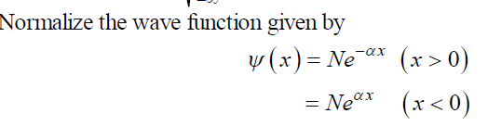
Normalization

Slide 6
Probability density
A particle in an infinite square well has a wave function that is given by
for 0 ≤ x ≤ L and is zero otherwise.
Determine the probability of finding the particle between x = 0 and x = L/3.

Slide 7
Solution:

Slide 8

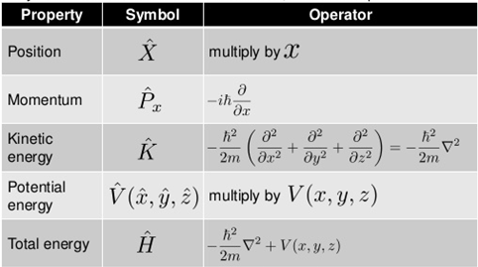
Operators

Slide 9

Quantum Mechanical Operators
Physical Quantity → Operators
symbol ↔ actual operation
↔ h ∂
Momentum
p → pˆ
x
x
i ∂x
Total Energy
E → E^{ˆ} ↔ ih ∂
∂t
x → xˆ ↔ x
U (x) →U^{ˆ} (x) ↔U (x)
Coordinate
Potential Energy

Slide 10
Eigen Value and Eigen Functions
Find the eigenvalues and eigenfunctions of the operator (d / dx) .
Ψ = Ce^{kx}
dΨ/dx = k Ce^{kx} = k Ψ
Eigen value = k

Slide 11
Expectation Value

Slide 12
Find the expected value of position and momentum of a particle whose wave function is

Slide 13
Particle in a box

Slide 14
Solution

Slide 15
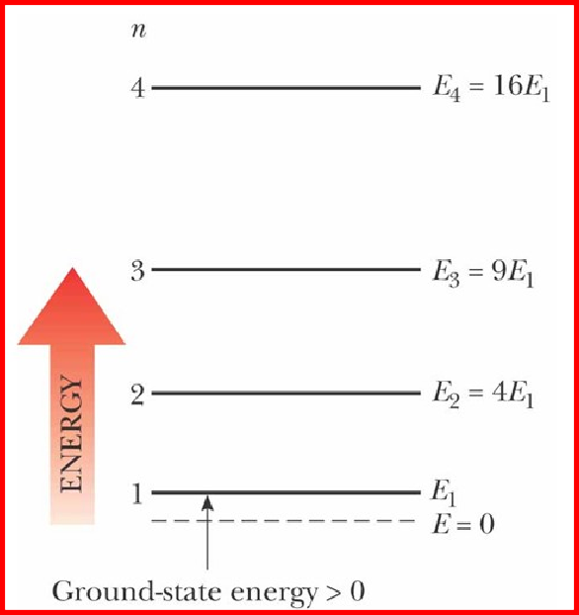
Ex-1: e⁻ in a 10nm wide Well with infinite barriers. Calculate E₀ for L = 10 nm
_{π} 22
3.14² (1.05×10⁻³⁴ )²
E₀ =
2
2 × 9.1×10⁻³¹ × (10 ×10⁻⁹ )²
E = E n , where E = E =
n 0 1 0
2mL
2
E ≈ 6 ×10⁻²² J = 0.00375 eV = 3.75 meV
0
1 meV = 10⁻³ eV
Ex-2: Assume that a photon is absorbed, and the electron is transferred from the ground state (n =
1) to the second excited state (n = 3). What was the wavelengths of the photon?
E_{ground} ≡ E₁ = E₀ = 0.00375 eV
Third excited state is E₃
E₃ = E₀ × 3² = 9 × 0.00375 eV ≈ 0.0338 eV
(hν) = E₃ −E₁ = 0.0338 −0.00375 ≈ 0.030 eV
λ = ¹²⁴⁰ ≈ 41333 nm ≈ 41μm
0.03
3₃0₀

Slide 16
Tunnel Effect
An electron has a kinetic energy of 12.0 eV. The electron is incident upon a rectangular barrier of height 20.0 eV and thickness 1.00 nm. By what factor would the electron’s probability of tunneling through the barrier increase assuming that the electron absorbs all the energy of a photon with wavelength 546 nm (green light)?

Slide 17
Solution

